Slide 1
Inter Process Communication

Slide 2
Revision of process related concepts
PCB, struct proc
Process lifecycle – different states
Memory layout
Memory management
Interrupts handling, system call handling, code from xv6
Scheduler, code of scheduler in xv6

Slide 3
IPC: Inter Process Communication
Processes within a system may be independent or cooperating
Cooperating process can affect or be affected by other processes, including sharing data
Reasons for cooperating processes:
  Information sharing, e.g. copy paste
  Computation speedup, e.g. matrix multiplication
  Modularity, e.g. chrome – separate process for display, separate for fetching data
  Convenience ,
Cooperating processes need interprocess communication (IPC)
Two models of IPC
  Shared memory
  Message passing

Slide 4
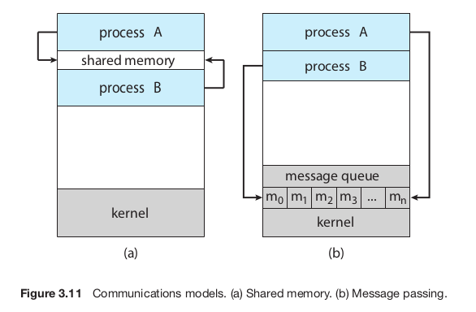
Shared Memory Vs Message Passing
Each requires OS to provide system calls for
  Creating the IPC mechanism
  To read/write using the IPC mechanism
  Delete the IPC mechanism
Note: processes communicating with each other with the help of OS!

Slide 5
Example of co-operating processes: Producer Consumer Problem
Paradigm for cooperating processes, producer process produces information that is consumed by a consumer process
  unbounded-buffer places no practical limit on the size of the buffer
  bounded-buffer assumes that there is a fixed buffer size

Slide 6
Example of co-operating processes: Producer Consumer Problem
Shared data
#define BUFFER_SIZE 10
typedef struct {
. . .
} item;
item buffer[BUFFER_SIZE];
int in = 0;
int out = 0;
Can only use BUFFER_SIZE-1 elements

Slide 7
Example of co-operating processes: Producer Consumer Problem
Code of Producer
while (true) {
/* Produce an item */
while (((in = (in + 1) % BUFFER SIZE count) == out)
; /* do nothing -- no free buffers */
buffer[in] = item;
in = (in + 1) % BUFFER SIZE;
}

Slide 8
Example of co-operating processes: Producer Consumer Problem
Code of Consumer
while (true) {
while (in == out)
; // do nothing -- nothing to consume
// remove an item from the buffer
item = buffer[out];
out = (out + 1) % BUFFER SIZE;
return item;
}

Slide 9
Pipes

Slide 10
Pipes for IPC
Two types
  Unnamed Pipes or ordinary pipes
  Named Pipe

Slide 11
Ordinary pipes
Ordinary Pipes allow communication in standard producer-consumer style
Producer writes to one end (the write-end of the pipe)
Consumer reads from the other end (the read-end of the pipe)
Ordinary pipes are therefore unidirectional
Requires a parent-child (or sibling, etc) kind of relationship between communicating processes

Slide 12
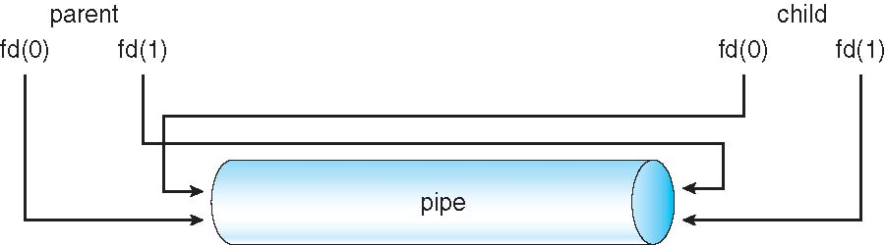

Slide 13
Named pipes
Also called FIFO
Processes can create a “file” that acts as pipe. Multiple processes can share the file to read/write as a FIFO
Named Pipes are more powerful than ordinary pipes
Communication is bidirectional
No parent-child relationship is necessary between the communicating processes
Several processes can use the named pipe for communication
Provided on both UNIX and Windows systems
Is not deleted automatically by OS

Slide 14
Named pipes
int mkfifo(const char *pathname, mode_t mode);
Example

Slide 15
Shared Memory

Slide 16
System V shared memory
Process first creates shared memory segment
  segment id = shmget(IPC_PRIVATE, size, S_IRUSR | S_IWUSR);
Process wanting access to that shared memory must attach to it
  shared_memory = (char *) shmat(id, NULL, 0);
Now the process could write to the shared memory
  sprintf(shared_memory, "Writing to shared memory");
When done, a process can detach the shared memory from its address space
  shmdt(shared_memory);

Slide 17
Example of Shared memory
POSIX Shared Memory
What is POSIX?
  Portable Operating System Interface (POSIX)
  family of standards
  specified by the IEEE Computer Society
  for maintaining compatibility between operating systems.
  API (system calls), shells, utility commands for compatibility among UNIXes and variants

Slide 18
POSIX Shared Memory
shm_open
ftruncate
Mmap
See the example in Textbook

Slide 19
Message passing

Slide 20
Message Passing
Message system – processes communicate with each other using send(), receive() like syscalls given by OS
IPC facility provides two operations:
  send(message) – message size fixed or variable
  Receive(message)
If P and Q wish to communicate, they need to:
  establish a communication link between them
  exchange messages via send/receive
Communication link can be implemented in a variety of ways

Slide 21
Message Passing using “Naming”
Pass a message by “naming” the receiver
  A) Direct communication with receiver
    Receiver is identified by sender directly using it’s name
  B) Indirect communication with receiver
    Receiver is identified by sender in-directly using it’s ‘location of receipt’

Slide 22
Message passing using direct communication
Processes must name each other explicitly:
  send (P, message) – send a message to process P
  receive(Q, message) – receive a message from process Q
Properties of communication link
  Links are established automatically
  A link is associated with exactly one pair of communicating processes
  Between each pair there exists exactly one link
  The link may be unidirectional, but is usually bi-directional

Slide 23
Message passing using IN-direct communication
Messages are directed and received from mailboxes (also referred to as ports)
  Each mailbox has a unique id
  Processes can communicate only if they share a mailbox
Properties of communication link
  Link established only if processes share a common mailbox
  A link may be associated with many processes
  Each pair of processes may share several communication links
  Link may be unidirectional or bi-directional

Slide 24
Message passing using IN-direct communication
Operations
  create a new mailbox
  send and receive messages through mailbox
  destroy a mailbox
Primitives are defined as:
  send(A, message) – send a message to mailbox A
  receive(A, message) – receive a message from mailbox A

Slide 25
Message passing using IN-direct communication
Mailbox sharing
  P1, P2, and P3 share mailbox A
  P1, sends; P2 and P3 receive
  Who gets the message?
Solutions
  Allow a link to be associated with at most two processes
  Allow only one process at a time to execute a receive operation
  Allow the system to select arbitrarily the receiver. Sender is notified who the receiver was.

Slide 26
Message Passing implementation: Synchronization issues
Message passing may be either blocking or non-blocking
Blocking is considered synchronous
  Blocking send has the sender block until the message is received
  Blocking receive has the receiver block until a message is available
Non-blocking is considered asynchronous
  Non-blocking send has the sender send the message and continue
  Non-blocking receive has the receiver receive a valid message or null

Slide 27
Producer consumer using blocking send and receive
Producer
message next produced;
while (true) {
/* produce an item in next_produced */
send(next_produced);
}
Consumer
message next_consumed;
while (true) {
receive(next_consumed);
}

Slide 28
Message Passing implementation: choice of Buffering
Queue of messages attached to the link; implemented in one of three ways
  1. Zero capacity – 0 messages
    Sender must wait for receiver (rendezvous)
  2. Bounded capacity – finite length of n messages
    Sender must wait if link full
  3. Unbounded capacity – infinite length
    Sender never waits

